Slide 1
Chapter 1 Introduction to Computers

Slide 2
Chapter 1 Objectives
Recognize the importance of computer literacy
Distinguish between system software and application software
Define the term, computer
Describe the categories of computers
Identify the components of a computer
Identify the elements of an information system
Discuss the advantages and disadvantages of using computers
Describe the various types of computer users
Recognize the purpose of a network
Discuss various computer applications in society
Discuss the uses of the Internet and World Wide Web
Next

Slide 3
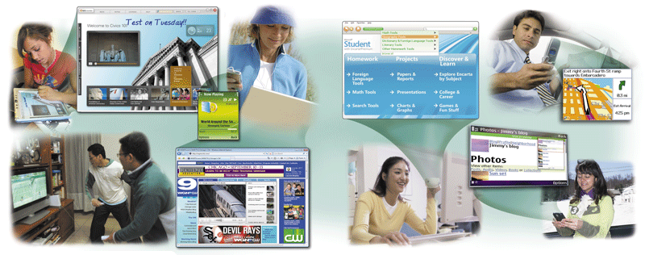
A World of Computers
What is computer literacy (digital literacy)?
Current knowledge and understanding of computers and their uses
Computers are everywhere
p. 4-5 Fig. 1-1
Next

Slide 4
What Is a Computer?
How is a computer defined?
Electronic device operating under the control of instructions stored in its own memory
Processes data into information
Conveys meaning and is useful to people
Accepts data
Collection of unprocessed items
Produces and stores results
p. 6
Next

Slide 5
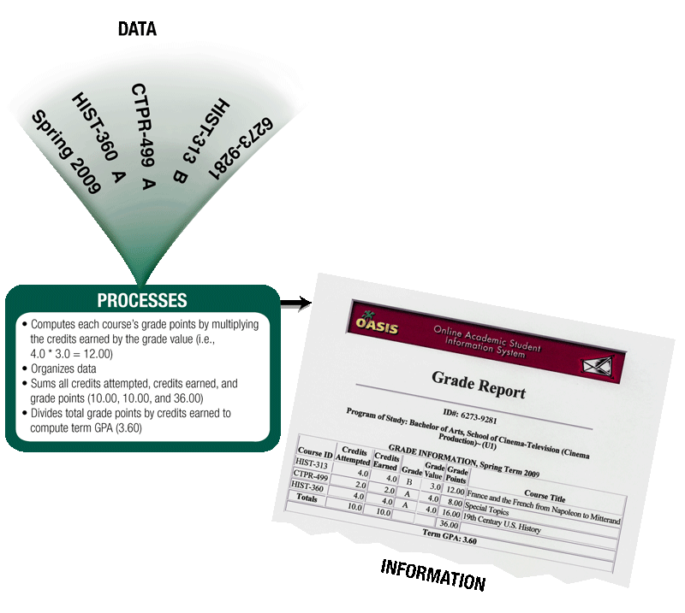
What Is a Computer?
What is the information processing cycle?
Input
Process
Output
Storage
Communication
p. 6 Fig. 1-2
Next

Slide 6
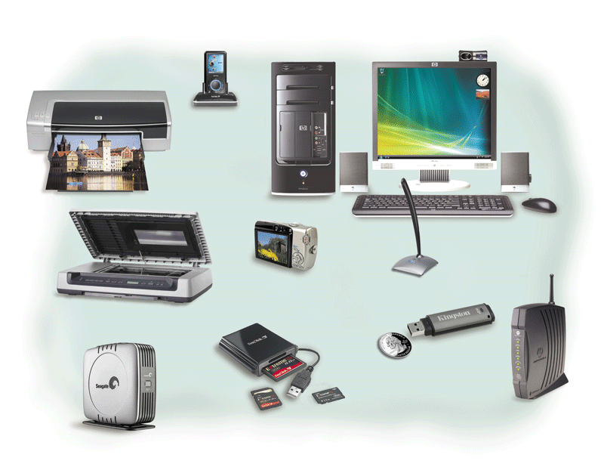
The Components of a Computer
What is an input device?
Hardware used
to enter data
and instructions
Click to view Web Link, click Chapter 1, Click Web Link from left navigation,
then click Input Devices below Chapter 1
p. 7 Fig. 1-3
Next

Slide 7
The Components of a Computer
What is an output device?
Hardware that
conveys information to one or more people
Click to view Web Link, click Chapter 1, Click Web Link from left navigation,
then click Output Devices below Chapter 1
p. 7 - 8 Fig. 1-3
Next

Slide 8
The Components of a Computer
What is the system unit?
Case that contains the electronic components of the computer that are used to process data
p. 7 - 8 Fig. 1-3
Next

Slide 9
The Components of a Computer
What are two main components on the motherboard?
Processor
Also called a Central Processing Unit (CPU)
The electronic component that interprets and carries out the basic instructions that operate the computer
Memory
Consists of electronic components that store instructions waiting to be executed and data needed by those instructions
p. 8
Next

Slide 10
The Components of a Computer
What is storage?
Holds data, instructions, and information for future use
Storage media
Physical material on which data, instructions, and information are stored
Storage device
Records and retrieves items to and from storage media
p. 8
Next

Slide 11
The Components of a Computer
What is a USB flash drive?
Portable storage device
Small and lightweight enough to be transported on a keychain or in a pocket
The average USB flash drive can hold about 2 billion characters
p. 8
Next

Slide 12
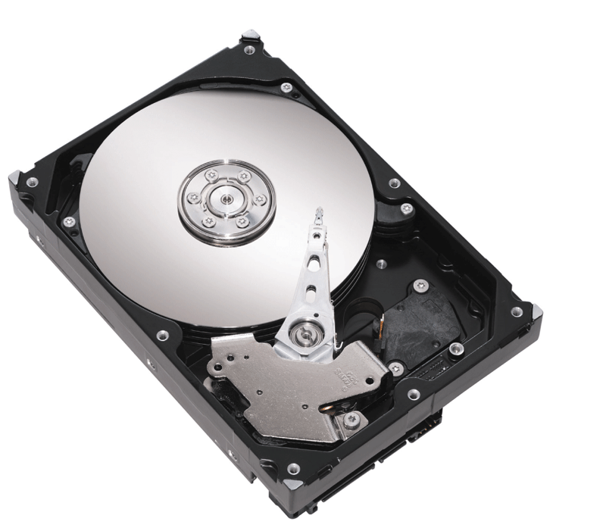
The Components of a Computer
What is a hard disk?
Provides greater storage capacity than a USB flash drive
Most are housed inside the system unit
p. 8 Fig. 1-4
Next

Slide 13
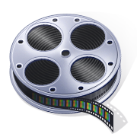
The Components of a Computer
Video: Speed Up Your Hard Drive
CLICK TO START
Next

Slide 14
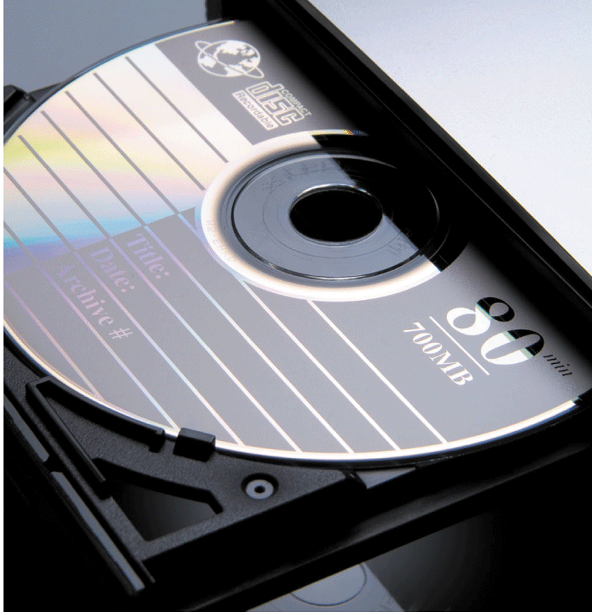
The Components of a Computer
What is a compact disc?
Flat, round, portable metal disc
CD
DVD
p. 9 Fig. 1-5
Next

Slide 15
The Components of a Computer
What is a communications device?
Hardware component that enables a computer to send and receive data, instructions, and information
Occurs over cables, telephone lines, cellular radio networks, satellites, and other transmission media
Click to view Web Link, click Chapter 1, Click Web Link from left navigation,
then click Communications Devices below Chapter 1
p. 9
Next

Slide 16
Advantages and Disadvantages of Using Computers
What are the advantages of using computers?
Reliability
Speed
Consistency
Storage
Communications
p. 10
Next

Slide 17
Advantages and Disadvantages of Using Computers
What are the disadvantages of using computers?
Violation of Privacy
Public Safety
Impact on Labor Force
Health Risks
Impact on Environment
p. 10 - 11
Next

Slide 18
Networks and the Internet
What is a network?
Collection of computers and devices connected together, often wirelessly
Used to share
Resources
Hardware devices
Software programs
Saves time and money
Data
Information
p. 11
Next

Slide 19
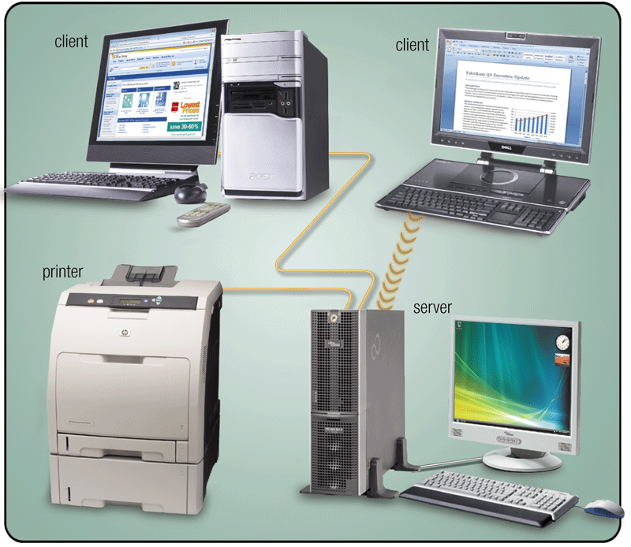
Networks and the Internet
What is a server?
A server controls access to resources on a network
Clients, or workstations, request resources from the server
p. 11 Fig. 1-6
Next

Slide 20
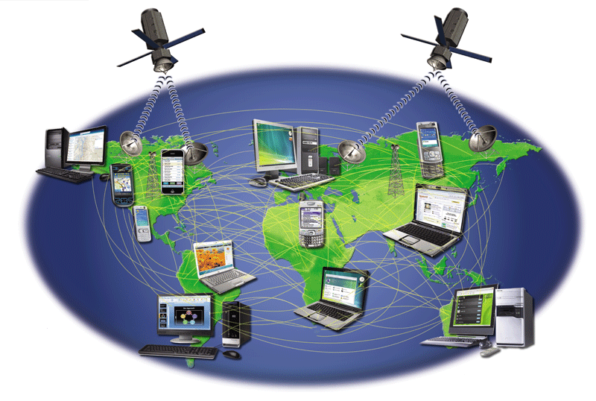
Networks and the Internet
What is the Internet?
Worldwide collection of networks that connects millions of businesses, government agencies, educational institutions, and individuals
Click to view Web Link, click Chapter 1, Click Web Link from left navigation,
then click Internet below Chapter 1
p. 12 Fig. 1-7
Next

Slide 21
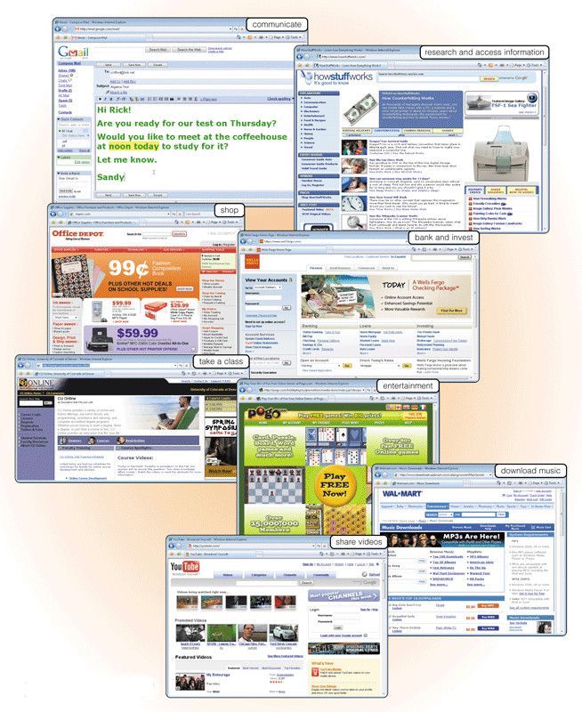
Networks and the Internet
Why do users access the Internet?
Communications
Research and Information
Shopping
Banking and Investing
Classes
Entertainment
7. Download Music
8. Share Information
p. 12 - 13 Fig. 1-8
Next

Slide 22
Networks and the Internet
What is the Web?
Billions of documents, called Web pages, available to anyone connected to the Internet
A Web site is a collection of related Web pages
You can share information on a social networking Web site or a photo sharing community
A podcast is recorded audio stored on a Web site that can be downloaded
A Web page contains text, graphics, audio, video, and links to other Web pages
A blog consists of time- stamped articles in a journal format
Click to view Web Link, click Chapter 1, Click Web Link from left navigation,
then click Sharing Videos below Chapter 1
p. 12 - 14
Next

Slide 23
Computer Software
What is software?
Consists of a series of instructions that tells the computer what to do and how to do it
Also called a program
p. 15
Next

Slide 24
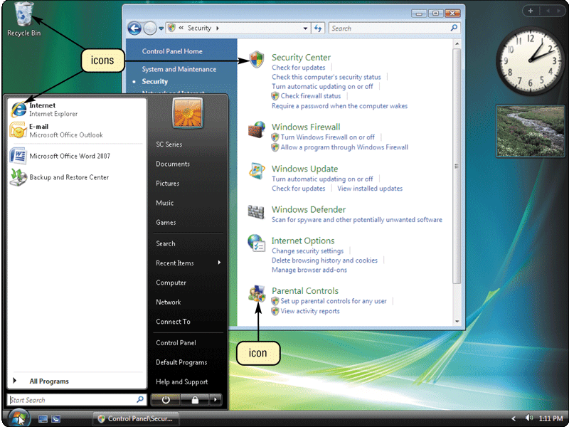
Computer Software
What is a graphical user interface (GUI)?
Allows you to interact with the software using text, graphics, and visual images such as icons
Controls how you enter data and instructions and how the screen displays information
p. 15 Fig. 1-10
Next

Slide 25
Computer Software
What is system software?
Programs that control or maintain the operations of the computer and its devices
Operating System (OS) is a set of programs that coordinates all activities among computer hardware devices
Utility Programs allow the user to perform maintenance-type tasks usually related to managing a computer, its devices or its programs
Click to view Web Link, click Chapter 1, Click Web Link from left navigation, then click Windows Vista below Chapter 1
p. 15-16
Next

Slide 26
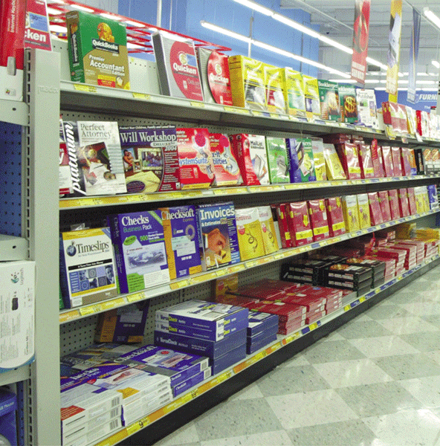
Computer Software
What is application software?
Programs designed to make users more productive
Word Processing
Spreadsheet
Database
Presentation Graphics
p. 16 Fig. 1-11
Next

Slide 27
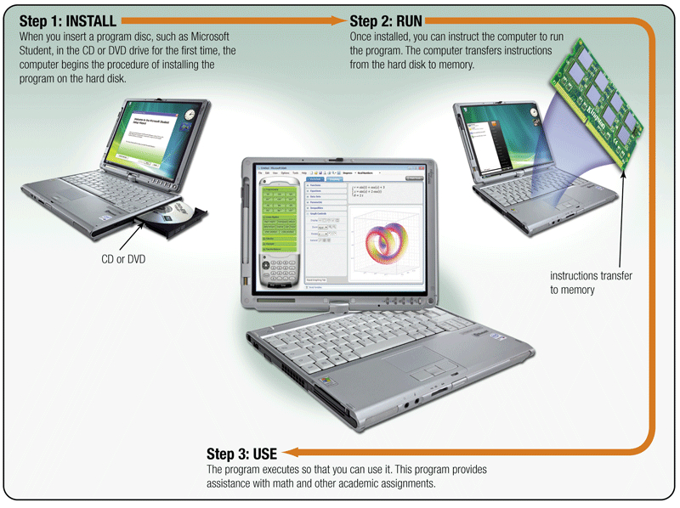
Computer Software
How do you install and run programs?
p. 17 Fig. 1-12
Next

Slide 28
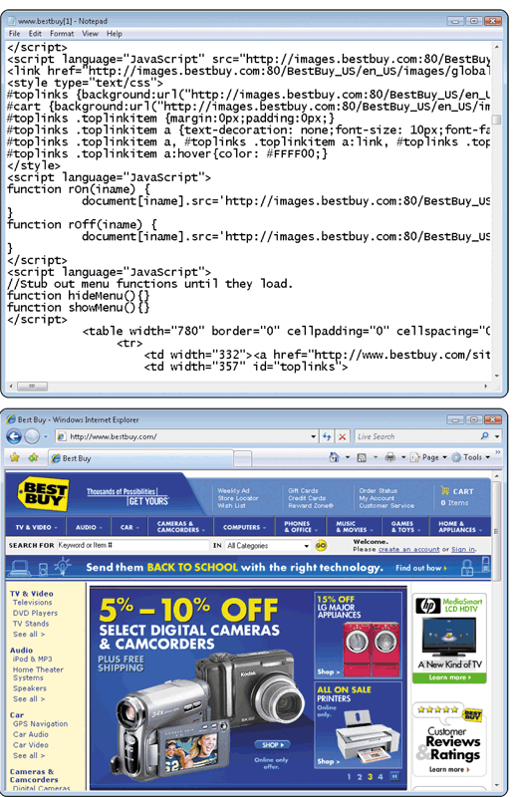
Computer Software
JavaScript
What is a programmer?
Someone who develops software
Programmer writes the instructions to direct the computer to process data into information
Web application
p. 18 Fig. 1-13
Next

Slide 29
Categories of Computers
What are the categories of computers?
Personal Computers (desktop)
Mobile Computers and Mobile Devices
Game Consoles
Servers
Mainframes
Supercomputers
Embedded Computers
p. 19
Next

Slide 30
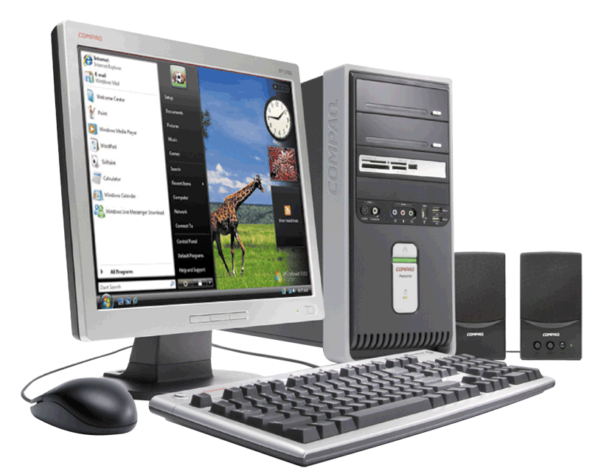
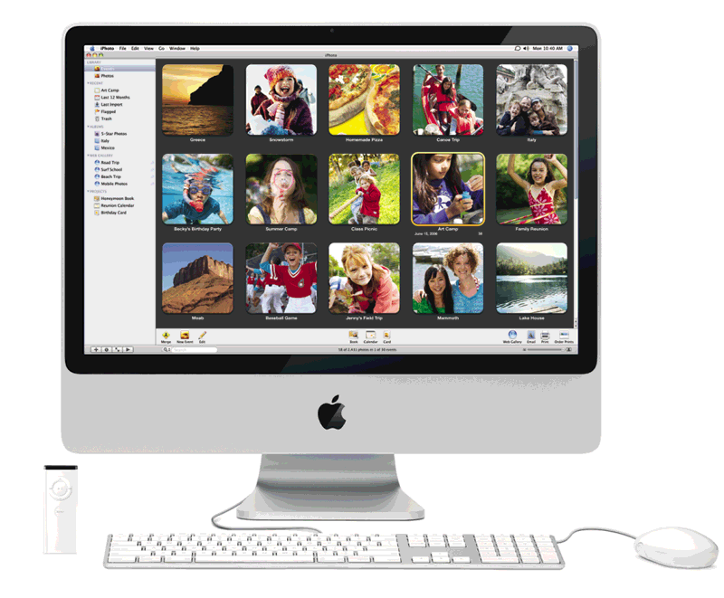
Personal Computers
What are the two most popular styles of personal computers?
PC and compatibles use the Windows operating system
Apple Macintosh usually uses the Macintosh operating system (Mac OS X)
Click to view Web Link, click Chapter 1, Click Web Link from left navigation, then click Personal Computers below Chapter 1
p. 19 - 20 Figs. 1-15–1-16
Next

Slide 31
Personal Computers
What is a desktop computer?
Designed so all of the components fit entirely on or under a desk or table
p. 19-20 Fig. 1-15
Next

Slide 32
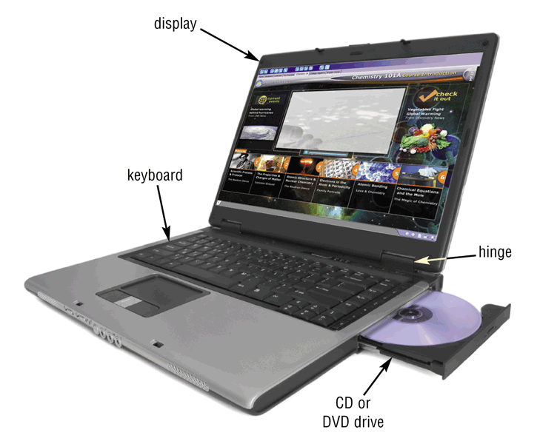
Mobile Computers and Mobile Devices
What is a notebook computer?
Portable, small enough to fit on your lap
Also called a laptop computer
Usually more expensive than a desktop computer with equal capabilities
p. 20 Fig. 1-17
Next

Slide 33
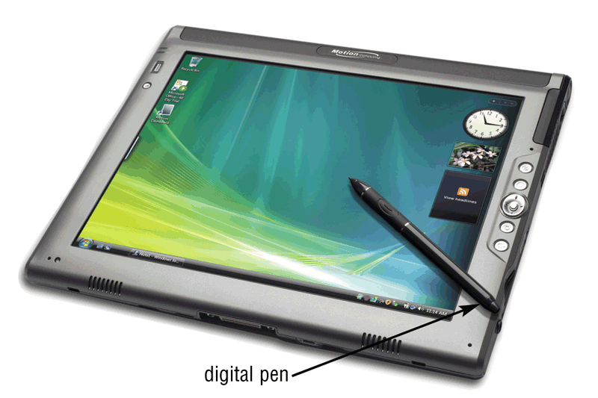
Mobile Computers and Mobile Devices
What is a Tablet PC?
Resembles a letter-sized slate
Allows you to write on the screen using a digital pen
Especially useful for taking notes
p. 21 Fig. 1-18
Next

Slide 34
Mobile Computers and Mobile Devices
What are mobile devices?
Small enough to carry in a pocket
Internet-enabled telephone is a “smart phone”
p. 21 - 22
Next

Slide 35
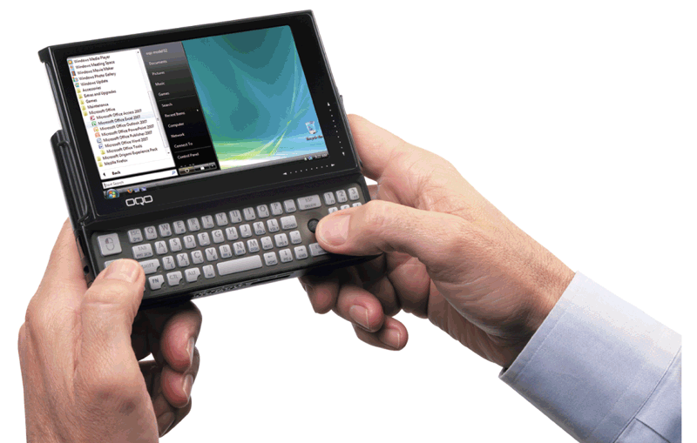
Mobile Computers and Mobile Devices
What is a handheld computer?
Used by mobile employees such as meter readers and delivery people
Small enough to fit in one hand
p. 21 Fig. 1-19
Next

Slide 36
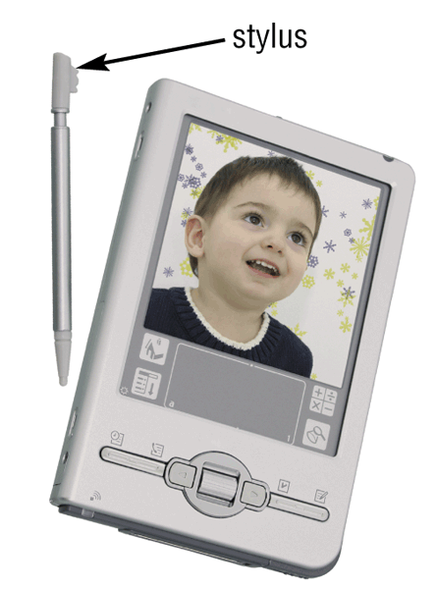
Mobile Computers and Mobile Devices
What is a personal digital assistant (PDA)?
Provides personal organizer functions
Calendar
Appointment book
Address book
Calculator
Notepad
p. 21 Fig. 1-20
Next

Slide 37
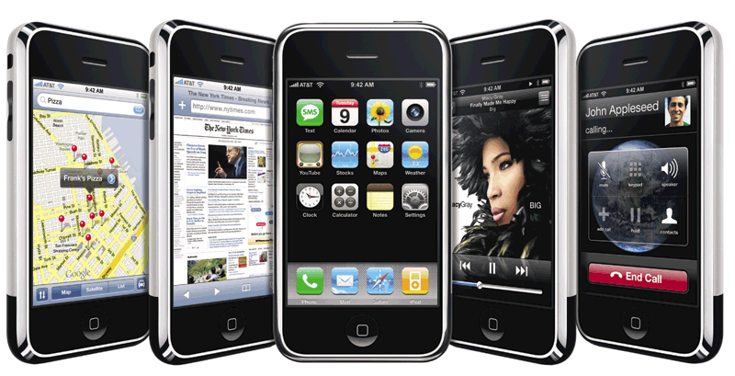
Mobile Computers and Mobile Devices
What are smart phones?
Click to view Web Link, click Chapter 1, Click Web Link from left navigation, then click iPhone below Chapter 1
p. 22 Fig. 1-21
Next

Slide 38
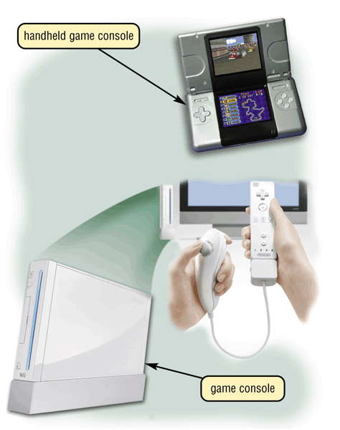
Game Consoles
What are game consoles?
Mobile computing device designed for single-player or multiplayer video games
p. 22 Fig. 1-22
Next

Slide 39
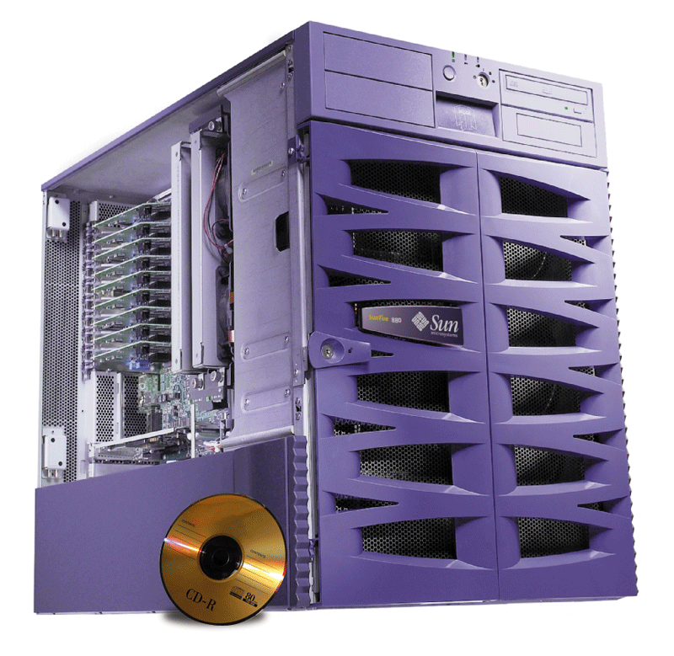
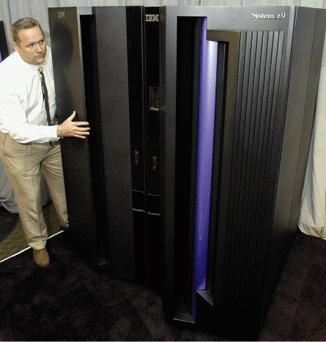
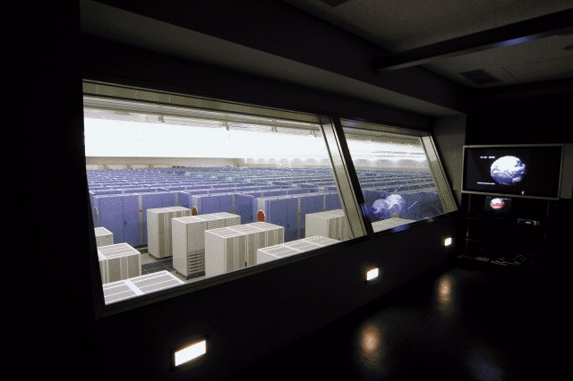
Servers
What types of servers are there?
A server controls access to network resources and provides centralized storage
Mainframe Very powerful, expensive computer that supports thousands of connected users
Supercomputer The fastest, most powerful, most expensive computer. Used for applications requiring complex mathematical calculations
p. 23 Figs. 1-23 – 1-25
Next

Slide 40
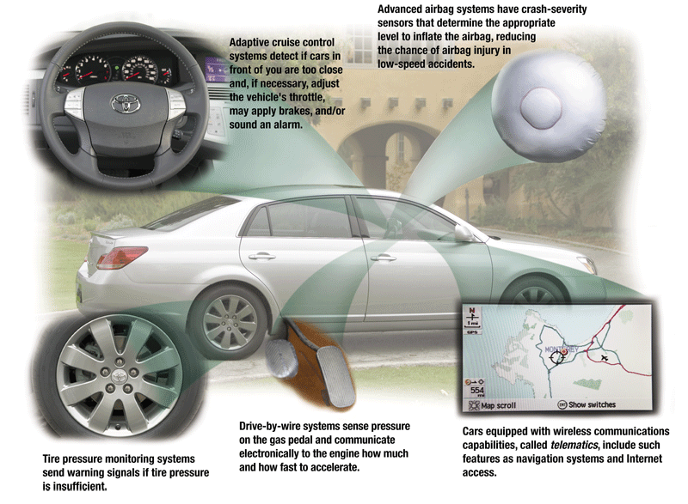
Embedded Computers
What is an embedded computer?
A special-purpose computer that functions as a component in a larger product
p. 24 Fig. 1-26
Next

Slide 41
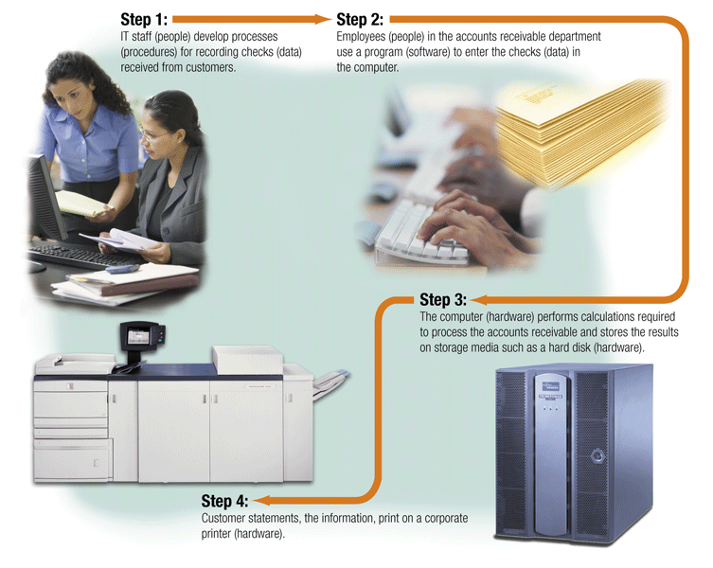
Elements of an Information System
What are information system elements?
Hardware
Software
Data
People
Procedures
p. 25 Fig. 1-27
Next

Slide 42
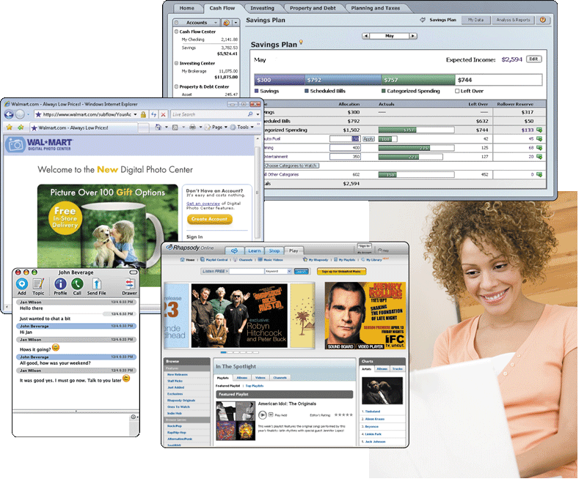
Examples of Computer Usage
What software is available for a home user?
Personal finance management
Web access
Communications
Entertainment
Click to view Web Link, click Chapter 1, Click Web Link from left navigation, then click Women in Technology below Chapter 1
Click to view Web Link, click Chapter 1, Click Web Link from left navigation, then click Minorities in Technology below Chapter 1
Next
p. 26 Fig. 1-28

Slide 43
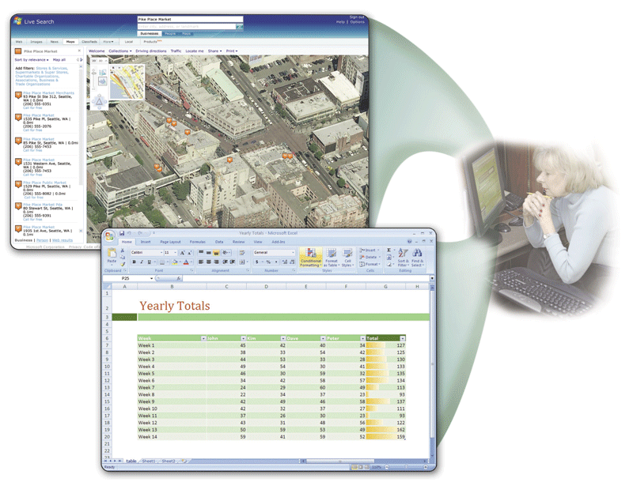
Examples of Computer Usage
What software is available for a small office/home office (SOHO) user?
Productivity software
Specialty software
Web usage
E-mail
p. 28 Fig. 1-30
Next

Slide 44
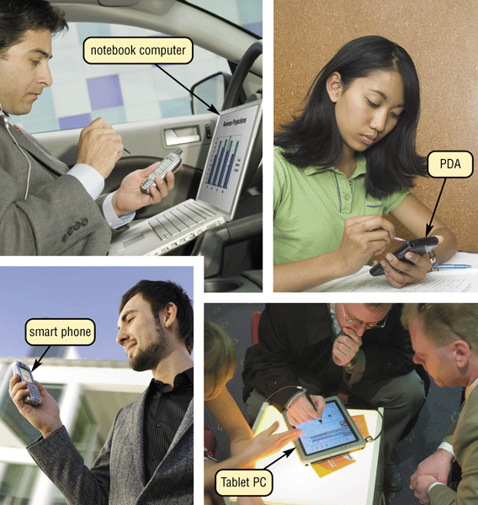
Examples of Computer Usage
What is available for a mobile user?
Hardware
Notebook computers
Tablet PCs
Internet-enabled PDAs
Smart phones
Software
Word processing
Spreadsheet
Presentation graphics software
p. 29 Fig. 1-31
Next

Slide 45
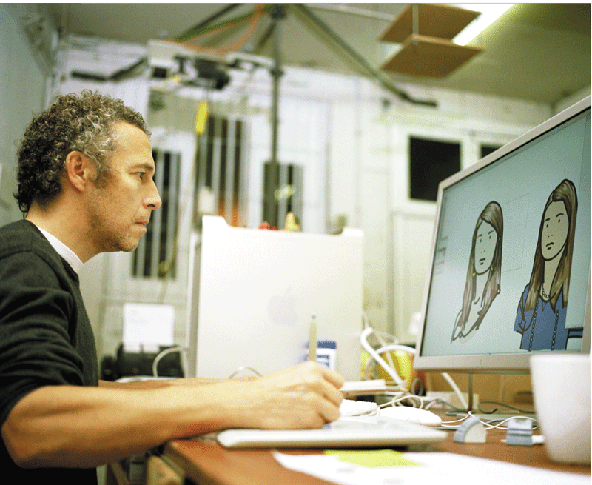
Examples of Computer Usage
What are the needs of a power user?
Speed and large amounts of storage
Types of power users
Engineers
Scientists
Architects
Desktop publishers
Graphic artists
p. 29 Fig. 1-32
Next

Slide 46
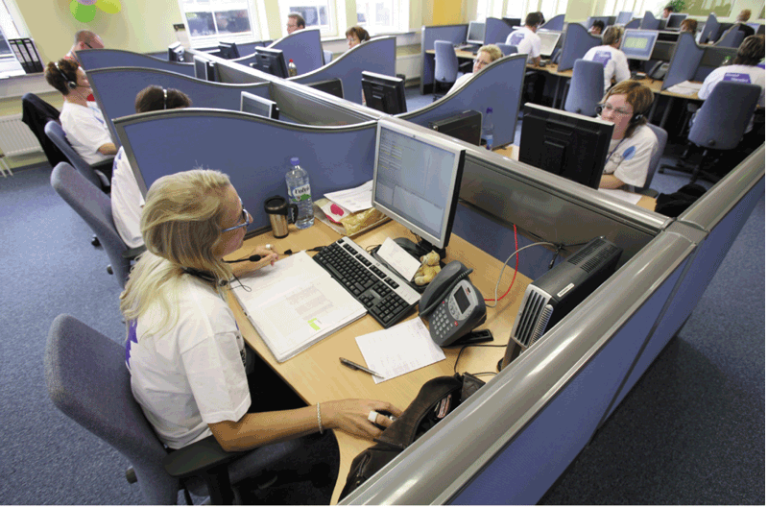
Examples of Computer Usage
What are the needs of the large business user?
Payroll
Inventory
E-commerce
Desktop publishing
p. 30 Figs. 1-33
Next

Slide 47

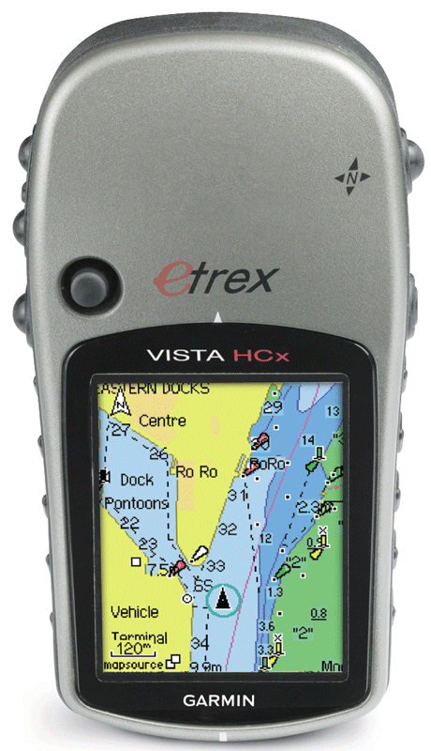
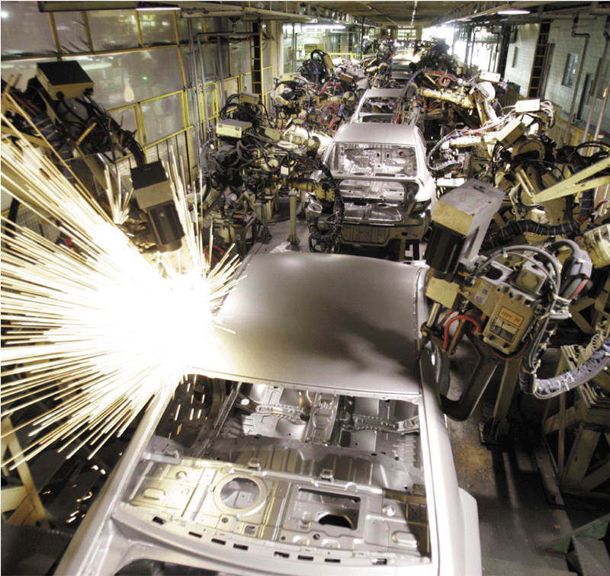
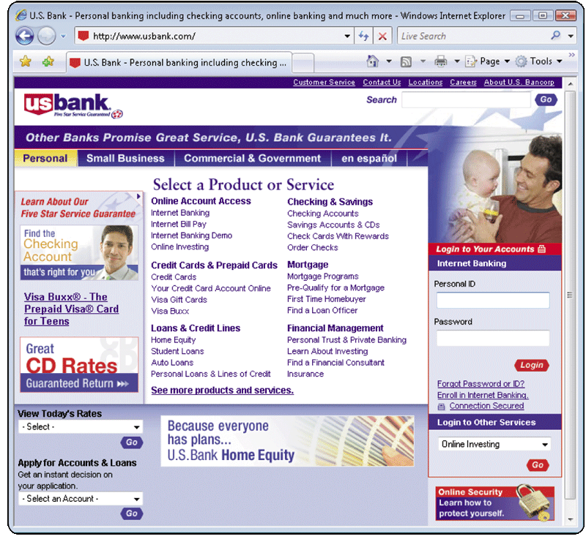
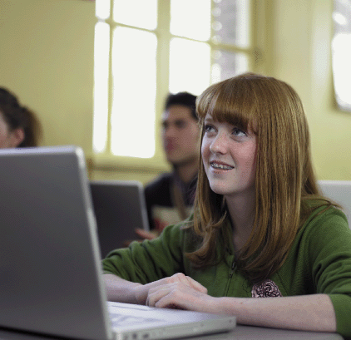
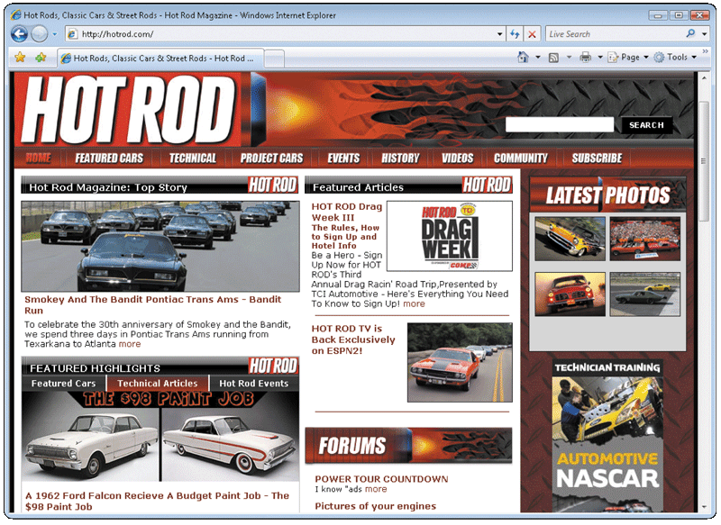
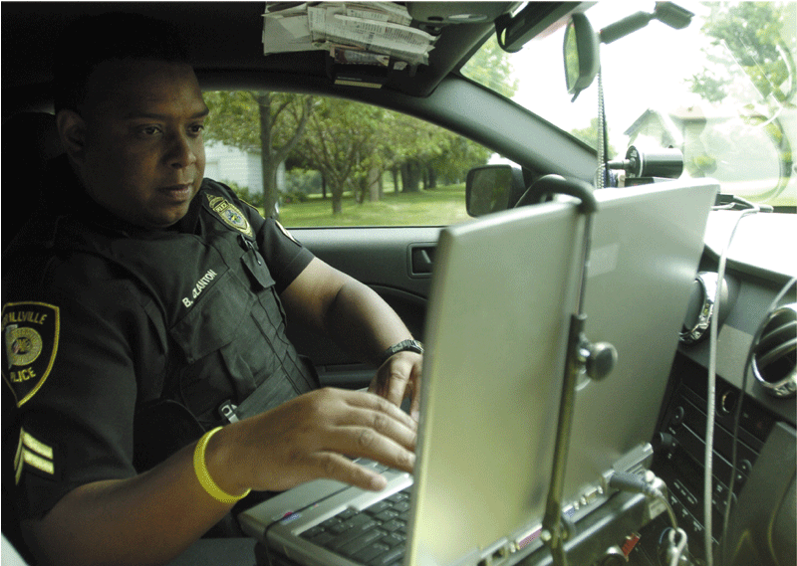
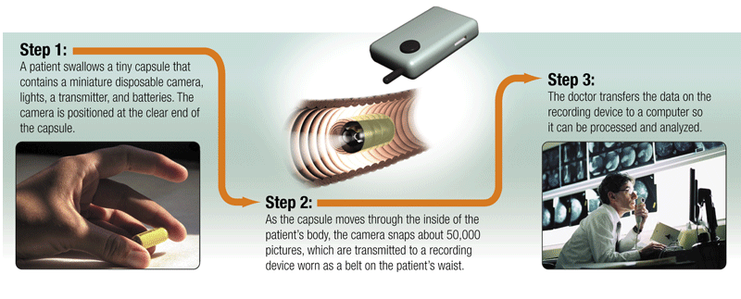
Computer Applications in Society
What are some examples of computer applications in society?
Education
Finance
Government
Health Care
Science
Publishing
Travel
Manufacturing
Click to view Web Link, click Chapter 1, Click Web Link from left navigation, then click Handheld Navigation Devices below Chapter 1
p. 32-36 Figs. 1-36–1-43
Next

Slide 48
Summary of Introduction to Computers
Basic computer concepts
The uses of the Internet
The term, computer
Computer software
The components of a computer
Categories of computers
The advantages and disadvantages of using computers
Types of computer users
The purpose of a network
Computer applications in society
Chapter 1 Complete

